Slide 1
Revolutionizing Liver Care : Predicting Liver Cirrhosis using Advanced Machine Learning Techniques

Slide 2
agenda
Introduction
Problem Statement
Proposed Solution
Dataset & Preprocessing
Model Selection
Implementation
Result
Challenges & Limitations
Future Scope
Conclusion

Slide 3
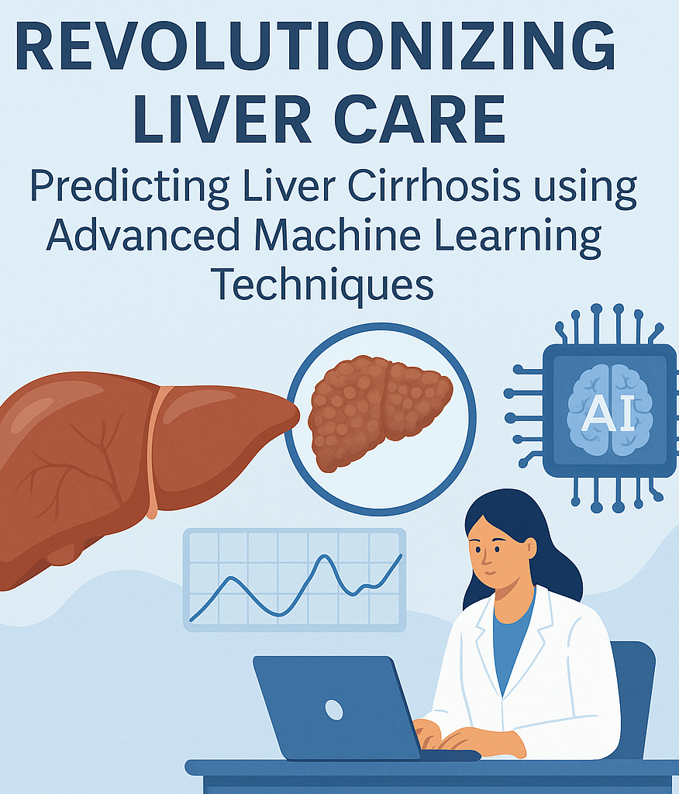
introduction 🩺 Why Liver Cirrhosis Matters Liver cirrhosis is the end stage of chronic liver diseases, often diagnosed too late for effective intervention. It causes over 2 million deaths annually worldwide, ranking as a top 10 global cause of death. Early diagnosis can significantly improve outcomes, reduce hospital costs, and save lives.

Slide 4
The Role of Machine Learning
Traditional diagnostic tools rely heavily on imaging and invasive biopsies, often detecting disease at advanced stages.
Machine Learning (ML) allows us to analyze large-scale patient data to detect subtle, early-stage patterns.
Predictive models can identify at-risk individuals months earlier, supporting proactive treatment and prevention.
💡 Project Focus
“This project leverages advanced machine learning techniques to predict liver cirrhosis earlier and more accurately, transforming how we approach liver disease management in the modern era.”

Slide 5
Problem statement
Silent, Late-Stage Detection
Up to half of patients first present with decompensated cirrhosis, when damage is already irreversible and mortality doubles.
Escalating Global Burden
Liver disease now causes ≈ 2 million deaths a year (≈ 4 % of all deaths), fuelled by NAFLD, alcohol misuse and unmet viral-hepatitis targets.
Crippling Economics
Decompensated cirrhosis costs ≈ US $47 k per patient-year—-55 % higher than COPD and 22 % higher than heart failure—straining health-system budgets.

Slide 6
Diagnostic Limitations
Ultrasound and biopsy detect scarring only after substantial fibrosis.
Common non-invasive scores (FIB-4, NFS) plateau at AUROC ≈ 0.70–0.80, missing subtle early signals.
Untapped Data Opportunity
Hospitals already collect longitudinal labs, imaging and clinical notes, yet these rich datasets are rarely leveraged for proactive prediction.

Slide 7
Proposed system
To address the limitations of conventional diagnostic methods, we propose a machine learning–based predictive system for early detection of liver cirrhosis. The system is designed to process and analyze clinical and biochemical data to assess cirrhosis risk in patients with high accuracy.
Key Components:
Data Collection & Preprocessing
Gather anonymized patient data including liver function tests, demographic info, and medical history. Clean and normalize the dataset to prepare it for analysis.
Feature Selection
Use statistical methods and domain knowledge to identify the most relevant features that contribute to cirrhosis progression.
Model Development
Implement various machine learning algorithms (e.g., Random Forest, Support Vector Machine, XGBoost) to build predictive models. Evaluate them using metrics like accuracy, precision, recall, and AUC-ROC.
.

Slide 8
Model Optimization
Fine-tune the best-performing models using techniques such as cross-validation and hyperparameter tuning to enhance performance and generalizability.
Prediction Interface
Develop a user-friendly application or dashboard that allows healthcare professionals to input new patient data and receive real-time risk assessments.
Interpretability & Clinical Validation
Ensure model outputs are interpretable and transparent, using tools like SHAP or LIME. Collaborate with medical experts to validate clinical relevance.

Slide 9
Dataset & preprocessing
For this project, we utilized a comprehensive dataset stored in an Excel file format (HealthCareData.xlsx), which contains detailed medical records relevant to liver health.
The dataset includes a variety of clinical features such as patient demographics (age, gender), biochemical indicators (bilirubin levels, albumin, enzymes), and diagnostic outcomes.
This rich data serves as the foundation for training machine learning models aimed at predicting liver cirrhosis at an early stage.
Each row in the dataset represents a patient record, and each column corresponds to a medical feature. Before proceeding with modeling, it was essential to explore and clean the data, handle missing values, encode categorical features, and scale numerical variables to ensure accuracy and performance.

Slide 10
MODEL SELECTION
We explored a diverse set of machine learning models suitable for classification:
Logistic Regression – for baseline performance and easy interpretability
Decision Tree – allows clear visualization of decision rules
Random Forest – ensemble model that improves accuracy and reduces overfitting
Support Vector Machine (SVM) – effective for high-dimensional feature spaces
XGBoost – gradient boosting model known for top-tier performance
K-Nearest Neighbors (KNN) – distance-based model for simple classification tasks
Naïve Bayes – a fast probabilistic classifier based on Bayes’ theorem, suitable for high-dimensional data
Ridge Classifier – a linear model using L2 regularization to reduce overfitting and handle multicollinearity
Models were chosen based on their robustness, interpretability, and relevance to medical prediction tasks.

Slide 11
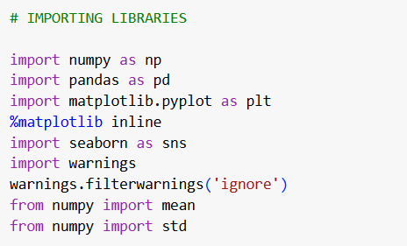
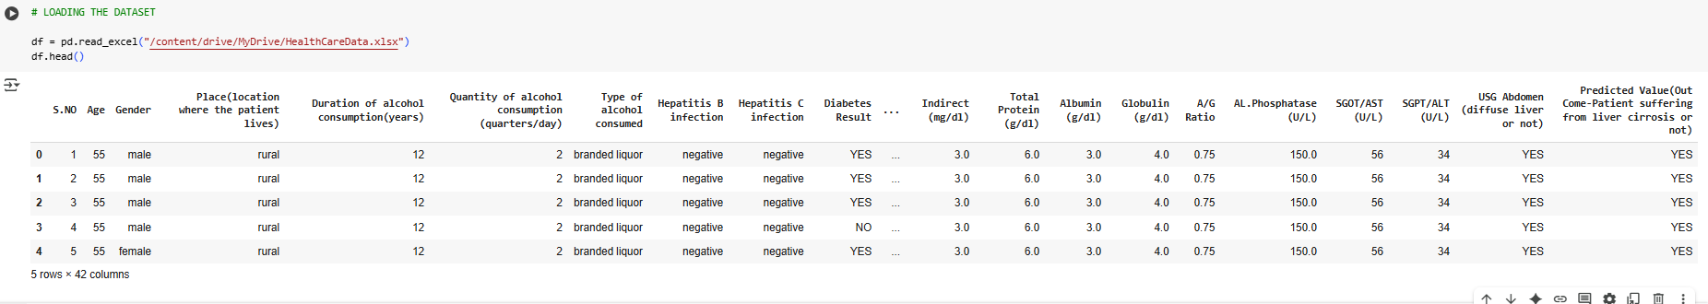
implementation
Importing the libraries
Read the Dataset

Slide 12
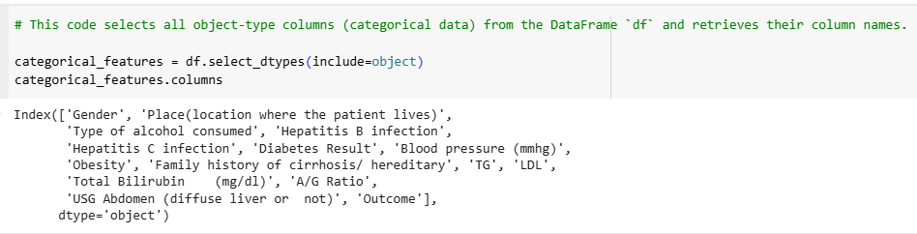
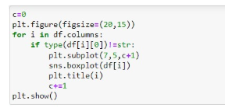
Handling categorical values
Handling outliers in Data

Slide 13
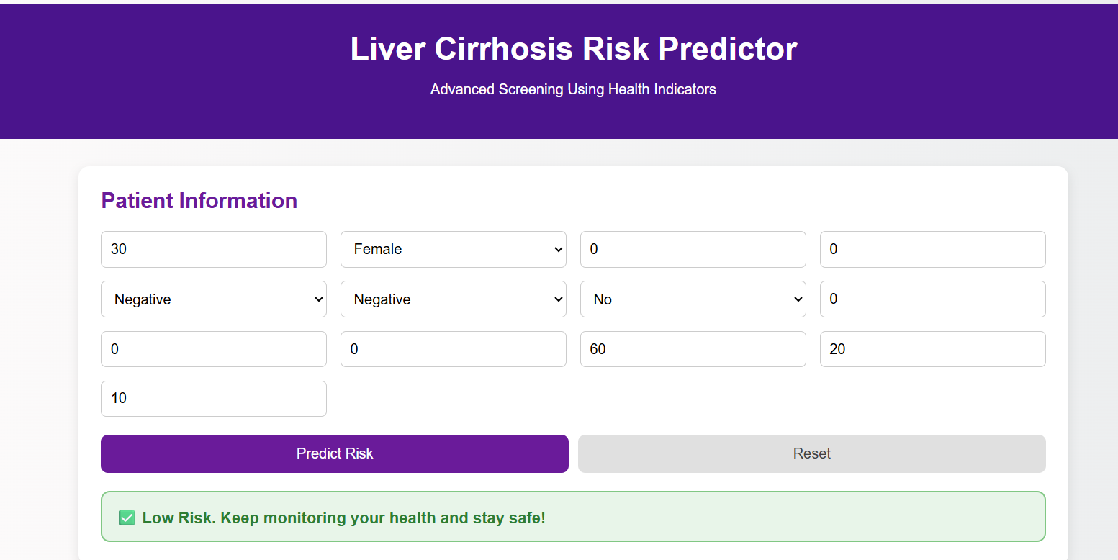
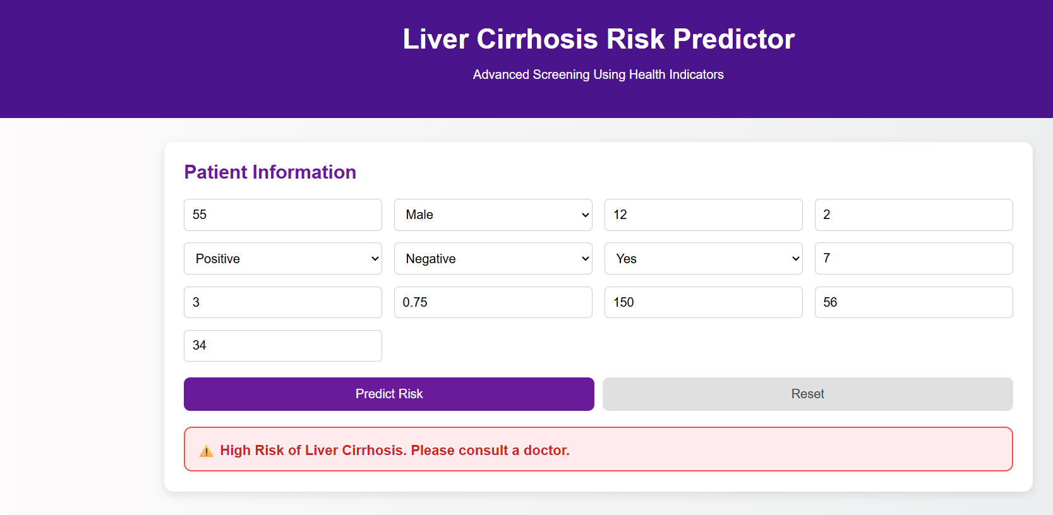
result

Slide 14
Challenges & Limitations
Limited Data: Small or poor-quality datasets can affect how well the model performs.
Uneven Classes: More non-cirrhosis than cirrhosis cases can create bias in prediction.
Complex Models: Some models are hard to understand, which can be tricky in healthcare.
Similar Features: Some features might be too alike, which can confuse the model.
Privacy Issues: It’s important to protect patient data and follow rules and ethics.
Generalization: A model trained on one group may not work well on others.
Model Updates: The model may need regular updates to stay accurate over time.

Slide 15
Future scope
Use in hospitals to help doctors make quick decisions
Predict other liver diseases like hepatitis or fatty liver
Suggest personalized treatments for each patient
Work with wearable health devices for early detection
Use larger and global datasets for better accuracy
Make AI models easier for doctors to understand and trust
CONCLUSION
This project shows how machine learning can play a key role in early detection of liver cirrhosis.
By using patient data and smart algorithms, we can improve diagnosis, help doctors make better decisions, and potentially save lives.
Although there are challenges, the results are promising, and with more data and development, this approach can become a powerful tool in modern healthcare.

Slide 16
Thank YOU
Team ID : LTVIP2025TMID33140
Team Leader : Manasa Ireddy
Team member : Jalluri Niharika
Team member : Bandaru Navya Geetha Lakshmi
Team member : Satya Anusha Sivakoti

